Slide 1
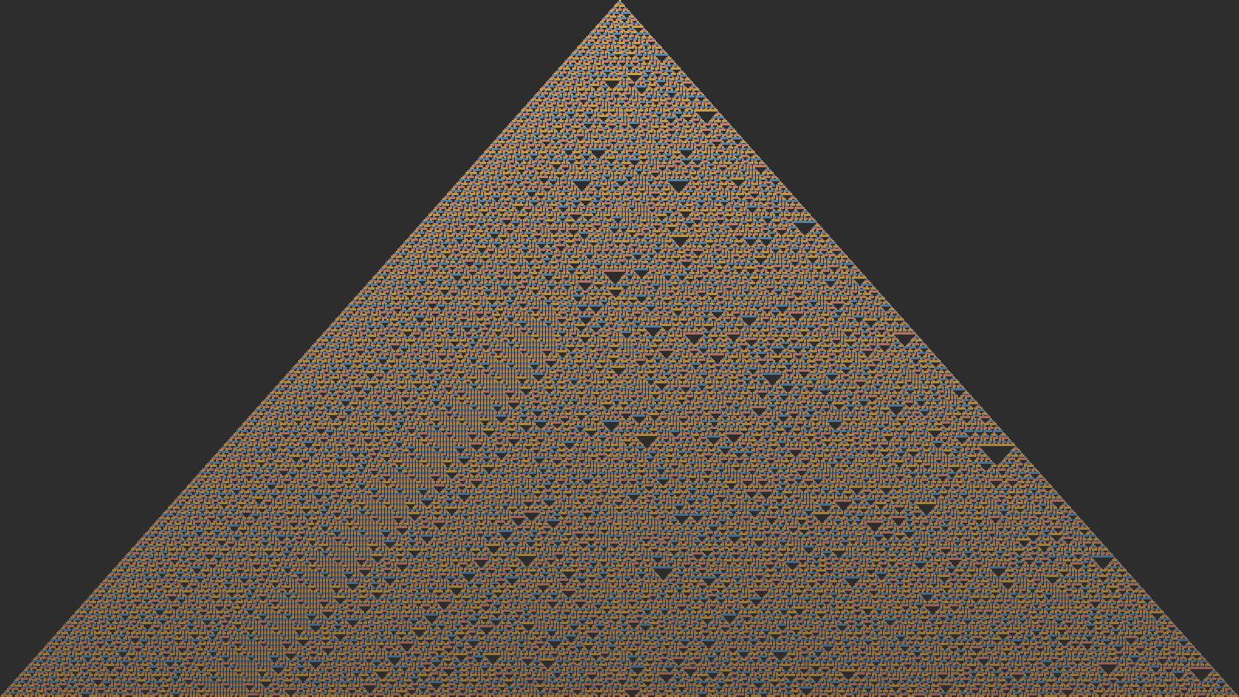
MAKING
WORLDS ALIVE
Entities · Rules · Emergence
Interaction Design 4 · NABA 2026

Slide 2
What if the world
didn't need you?
Most interactive experiences wait for the participant.
What happens when the world is already alive?

Slide 3
CELLULAR AUTOMATA
The simplest form of
a living world
A grid of cells. Each cell looks at its neighbors
and follows a rule to decide its next state.
No central control. No master plan.
Just local rules, applied everywhere, simultaneously.
Von Neumann (1940s) · Wolfram (1980s) · Conway (1970)
Rule 30 — Stephen Wolfram, 1983

Slide 4
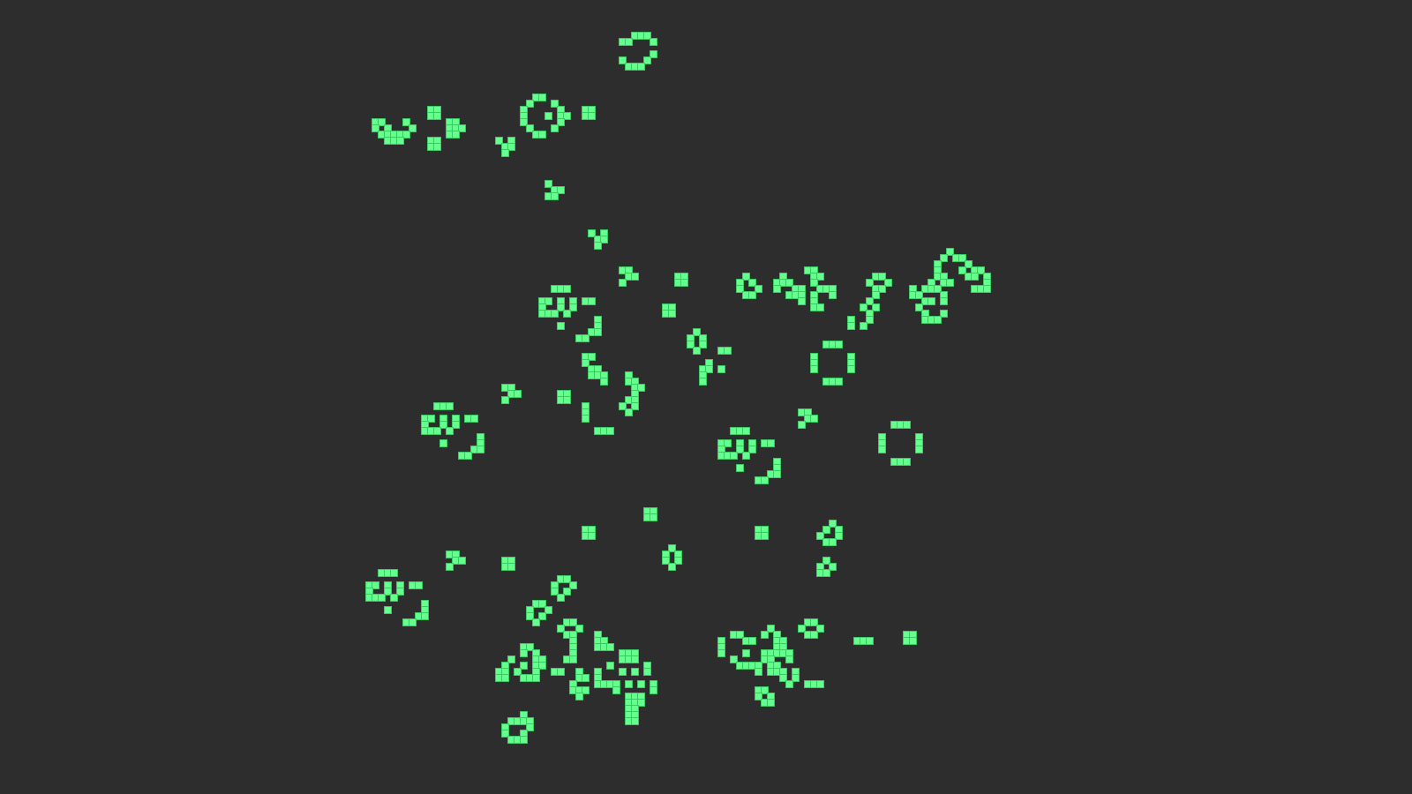
CONWAY'S GAME OF LIFE
Four rules.
Infinite complexity.
1. A live cell with < 2 neighbors dies (loneliness)
2. A live cell with 2–3 neighbors survives
3. A live cell with > 3 neighbors dies (overcrowding)
4. A dead cell with exactly 3 neighbors is born
From these four rules: gliders, oscillators, guns, computers.

Slide 5
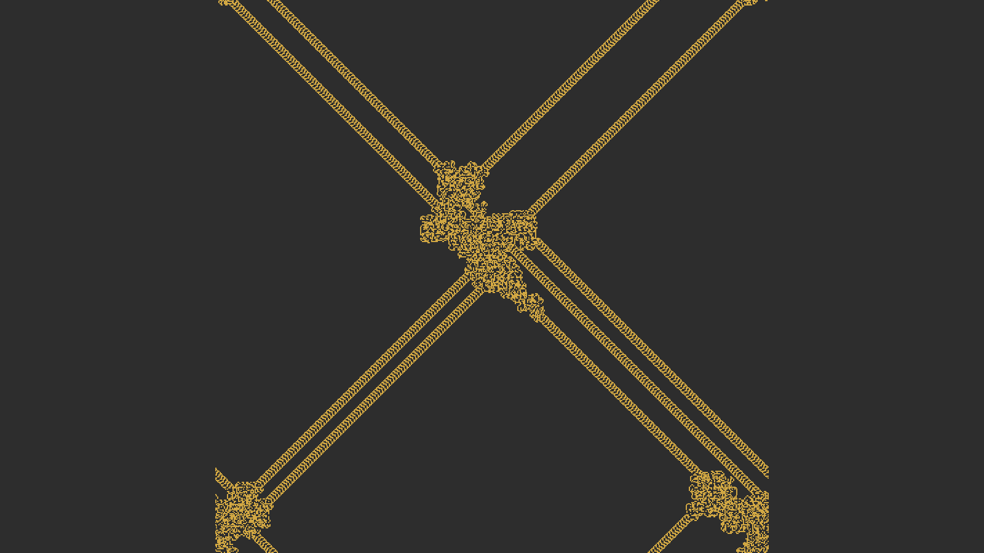
BEYOND THE GRID
Entities in
continuous space
Cellular automata live on grids — but the principle
is more general than the grid.
Replace "cell" with entity.
Replace "neighbor" with proximity.
Replace "state" with behavior.
Now your world has creatures, not pixels.
Langton's Ant — order from chaos, from two rules

Slide 6
THE RECIPE
Three ingredients for a living world
01
02
03
Entities
Rules
Interactions
Things that exist and have properties. Position, type, state, energy. The nouns of the world.
What each entity does on each tick. Move toward food. Flee from predators. Reproduce if healthy. The verbs.
What happens when entities meet. Consume, repel, attract, flee. The sentences — subject acts on object.
No designer intervention at runtime. The world runs itself.

Slide 7
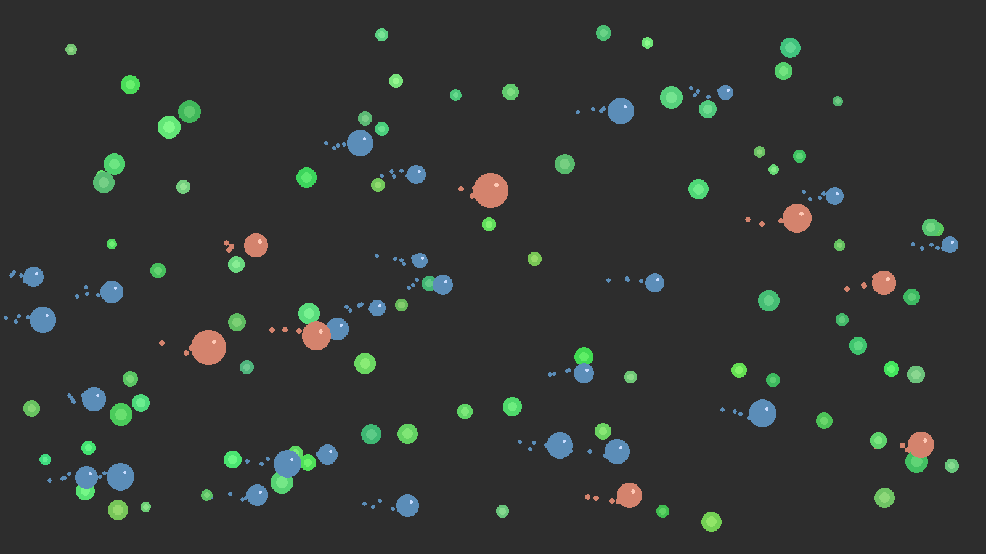
YOUR FIRST ECOSYSTEM
Flora, herbivores, carnivores
Flora
Static. Spawns periodically.
The base of the food chain.
Herbivores
Move randomly. Attracted to flora.
Consume on contact. Reproduce when fed.
Carnivores
Move toward herbivores.
Consume on contact. Larger, slower, fewer.

Slide 8
EMERGENT BEHAVIOR
What arises that
you didn't design?
What you author
What emerges
Entity types and their properties
Individual behavior rules
Interaction rules between types
Initial conditions and parameters
Population waves and crashes
Territorial clustering
Predator-prey oscillation
Strategies you never scripted
This is the horizon: setting conditions for meaning to arise.

Slide 9
REFERENCES
Where this thinking comes from
Conway's Game of Life
John Conway, 1970 — the canonical cellular automaton
Wolfram's Elementary CA
Stephen Wolfram, 1983 — Rule 30, Rule 110, A New Kind of Science
Boids
Craig Reynolds, 1986 — flocking behavior from three simple rules
Langton's Ant
Chris Langton, 1986 — order emerging from two rules and chaos
Braitenberg Vehicles
Valentino Braitenberg, 1984 — simple wiring, complex personalities
Artificial Life (ALife)
The field: life-as-it-could-be, not just life-as-we-know-it

Slide 10
Let's make
something alive.
Demo: cells that move, attract, repel, consume — from rules alone.

